Slide 1
PFAS Overview
Town Hall Discussion on PFAS Contamination in Santa Fe County
March 14, 2024

Slide 2
Meeting Manners
Mute Cell Phones
Limit side conversations
Be respectful
Thank you for coming!

Slide 3
Objective of this Presentation
Set context for our Town Hall discussion
Define PFAS
Explain why PFAS contamination of our air, water and bodies is a concern
Present an overview of the sources of PFAS contamination and exposure pathways
Provide an overview of the scope of PFAS contamination on a national and local level

Slide 4
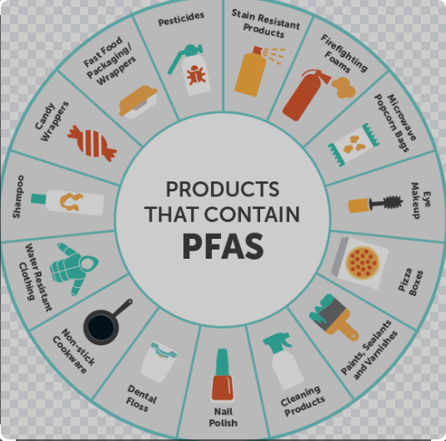
What is PFAS ? (per- and polyfluoroalkyl substances)
PFAS are human-made chemicals used in industry and consumer products since the 1940s
There are nearly 15,000 kinds of PFAS chemicals found in many different consumer, commercial, and industrial products:
Fast food packaging,
Cleaning products (waxes and polishes, dishwashing aids),
Clothing (water resistant jackets),
Stain resistant carpet,
Firefighting foam, and
Other products that resist grease, water, and oil.
Due to the widespread use of PFAS and the fact that they bioaccumulate, they are
found in the bodies of people and animals all over the world, as well as ground and
surface water.
(Source: EPA)

Slide 5
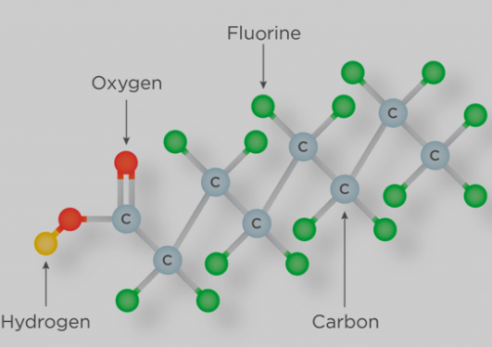
Why are we concerned about PFAS?
The epidemiological evidence suggest associations between increases in exposure to PFAS and certain health effects.
Increases in cholesterol levels (PFOA, PFOS, PFNA, PFDA)
Changes in liver enzymes (PFOA, PFOS, PFHxS)
Decreases in birth weight (PFOA, PFOS)
Lower antibody response to some vaccines (PFOA, PFOS, PFHxS, PFDA)
Pregnancy-induced hypertension and preeclampsia (PFOA, PFOS)
Kidney and testicular cancer (PFOA)
Research to understand how PFAS harms humans is ongoing.
The risk of health effects associated with PFAS depends on exposure factors (e.g., dose, frequency, route, and duration), individual factors (e.g., sensitivity and disease burden), and other determinants of health (e.g., access to safe water and quality healthcare).
(Source: ATSDR)

Slide 6
Sources of PFAS Pollution
Manufactured Products
The production of goods using labor, machinery, tools and biological or chemical processing or formulation.
Examples of some products that have historically contained PFAS include nonstick pans, electronics, food packaging, communication networks, carpets, cosmetics, etc.
Industrial Discharges
The act of introducing or depositing wastes from any non-domestic source into a public sewer, private sewer, or side sewer tributary
The Military
The military has historically used firefighting foam containing PFAS during emergencies or training exercises. Some of the highest levels of PFAS ever detected in groundwater have been found around military bases.
(Source: EWG)

Slide 7
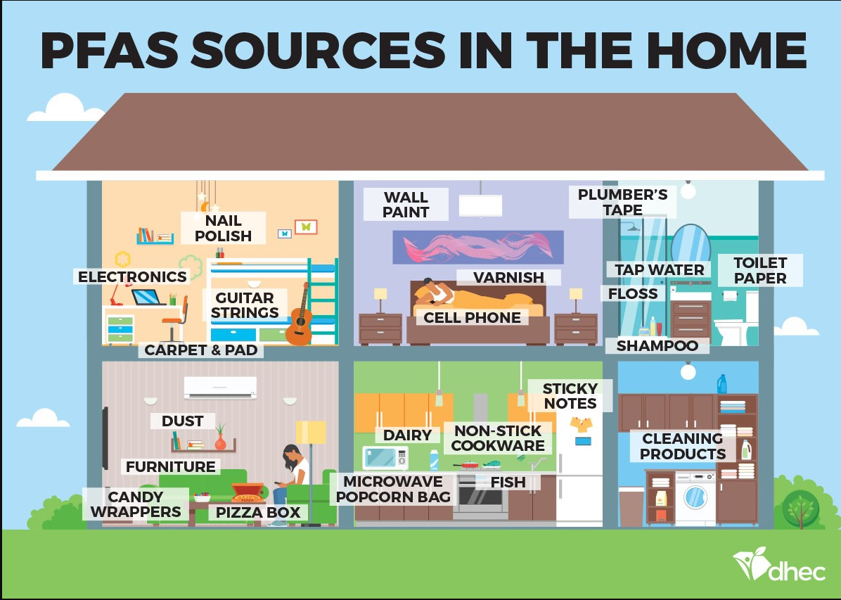
This graphic depicts the amount of PFAS sources in the average home.
EPA estimates that 80% of our exposure comes from sources other than drinking water.

Slide 8
Exposure Pathways
Nearly all people in the U.S. have had exposure to PFAS
Community Exposure: PFAS can get into our bodies when we:
drink water from PFAS-contaminated municipal sources or private wells,
eat fish caught from water contaminated by PFAS,
eat foods packaged in material that contain PFAS,
swallow or breathe in contaminated soil or dust, or
swallow residue or dust from consumer products containing PFAS, such as stain resistant carpeting and water repellent clothing.
Children: Young children may be more likely to get PFAS in their bodies because they tend to chew on toys and fabrics and often put their hands into their mouths. May also be exposed through formula made with PFAS contaminated water.
Workers: People whose work involves the making or processing of PFAS and PFAS-containing materials are more likely to be exposed than the general population. Some occupations that are known to be exposed through work are: Chemical manufacturing workers; Firefighters; Ski wax technicians.
(Source: ATSDR)

Slide 9
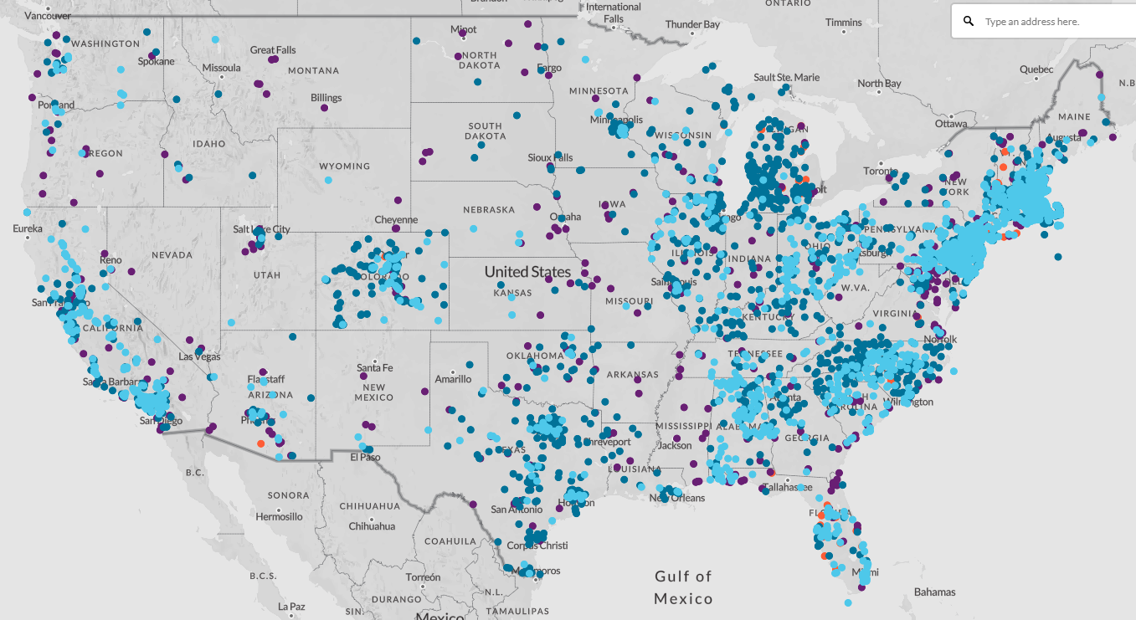
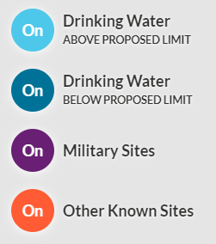
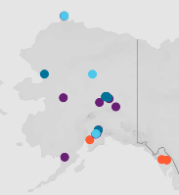
PFAS Contamination on a National Level
Data show 5,021 PFAS contamination sites or locations where PFAS have contaminated the environment and/or drinking water sources in 50 states, the District of Columbia and four territories.
(2/5/24)
(Source: Environmental Working Group (EWG):https://www.ewg.org/interactive-maps/pfas_contamination/map/)

Slide 10
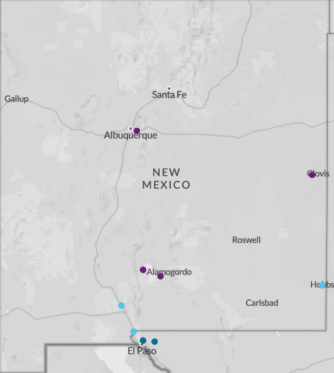
PFAS Contamination on a Local Level
Bernalillo County – Ground water contamination from firefighting foam used on Kirtland AFB.
Curry County – Ground water contamination from firefighting foam used on Cannon AFB. Highland Dairy in Clovis euthanized ~3600 cows in 2022
Dona Ana County –
White Sands Missile Range water distribution system contaminated from firefighting foam used on WSMR.
Dona Ana Mutual Domestic Water Consumers Association
Town of Anthony drinking water system
Lea County/Hobbs – Hobbs Municipal Water Supply – PFAS detected above proposed limit.
Otero County – Ground water contamination from firefighting foam used on Holloman AFB. Extremely high levels of PFAS contamination in nearly two dozen bird and mammal species at the lake near Holloman Air Force Base
Santa Fe County – Under investigation; known soil and ground water contamination at Army National Guard Aviation Support Facility and water from some wells in La Cienega and La Cieneguilla.
(Source: Environmental Working Group (EWG):https://www.ewg.org/interactive-maps/pfas_contamination/map/)

Slide 11
Meet the Speakers
Next up: Q&A – Speakers will answer your questions about PFAS contamination, remediation, and more.
To obtain assistance interpreting your well water PFAS test results, you can contact Andy Jochems with the NMED, Drinking Water Bureau. His card is on the back table – please take one.
To receive answers to your health questions via email, please leave your name, email and questions at the back table.

Slide 12
Next Steps
Monthly Meetings: 3rd Thursday of each month @ 6:00 p.m.
For Updates:
See Santa Fe County PFAS Webpage:https://www.santafecountynm.gov/public-works/pfas
LCVA List Serve: to Register Please provide your contact information (name, address, phone and email) via email to: lacienegavalleyinfo@gmail.com
For more information, contact:
LSVA @ lacienegavalleyinfo@gmail.com
Shelly Moeller @ psiimoeller@gmail.com

